Slide 1
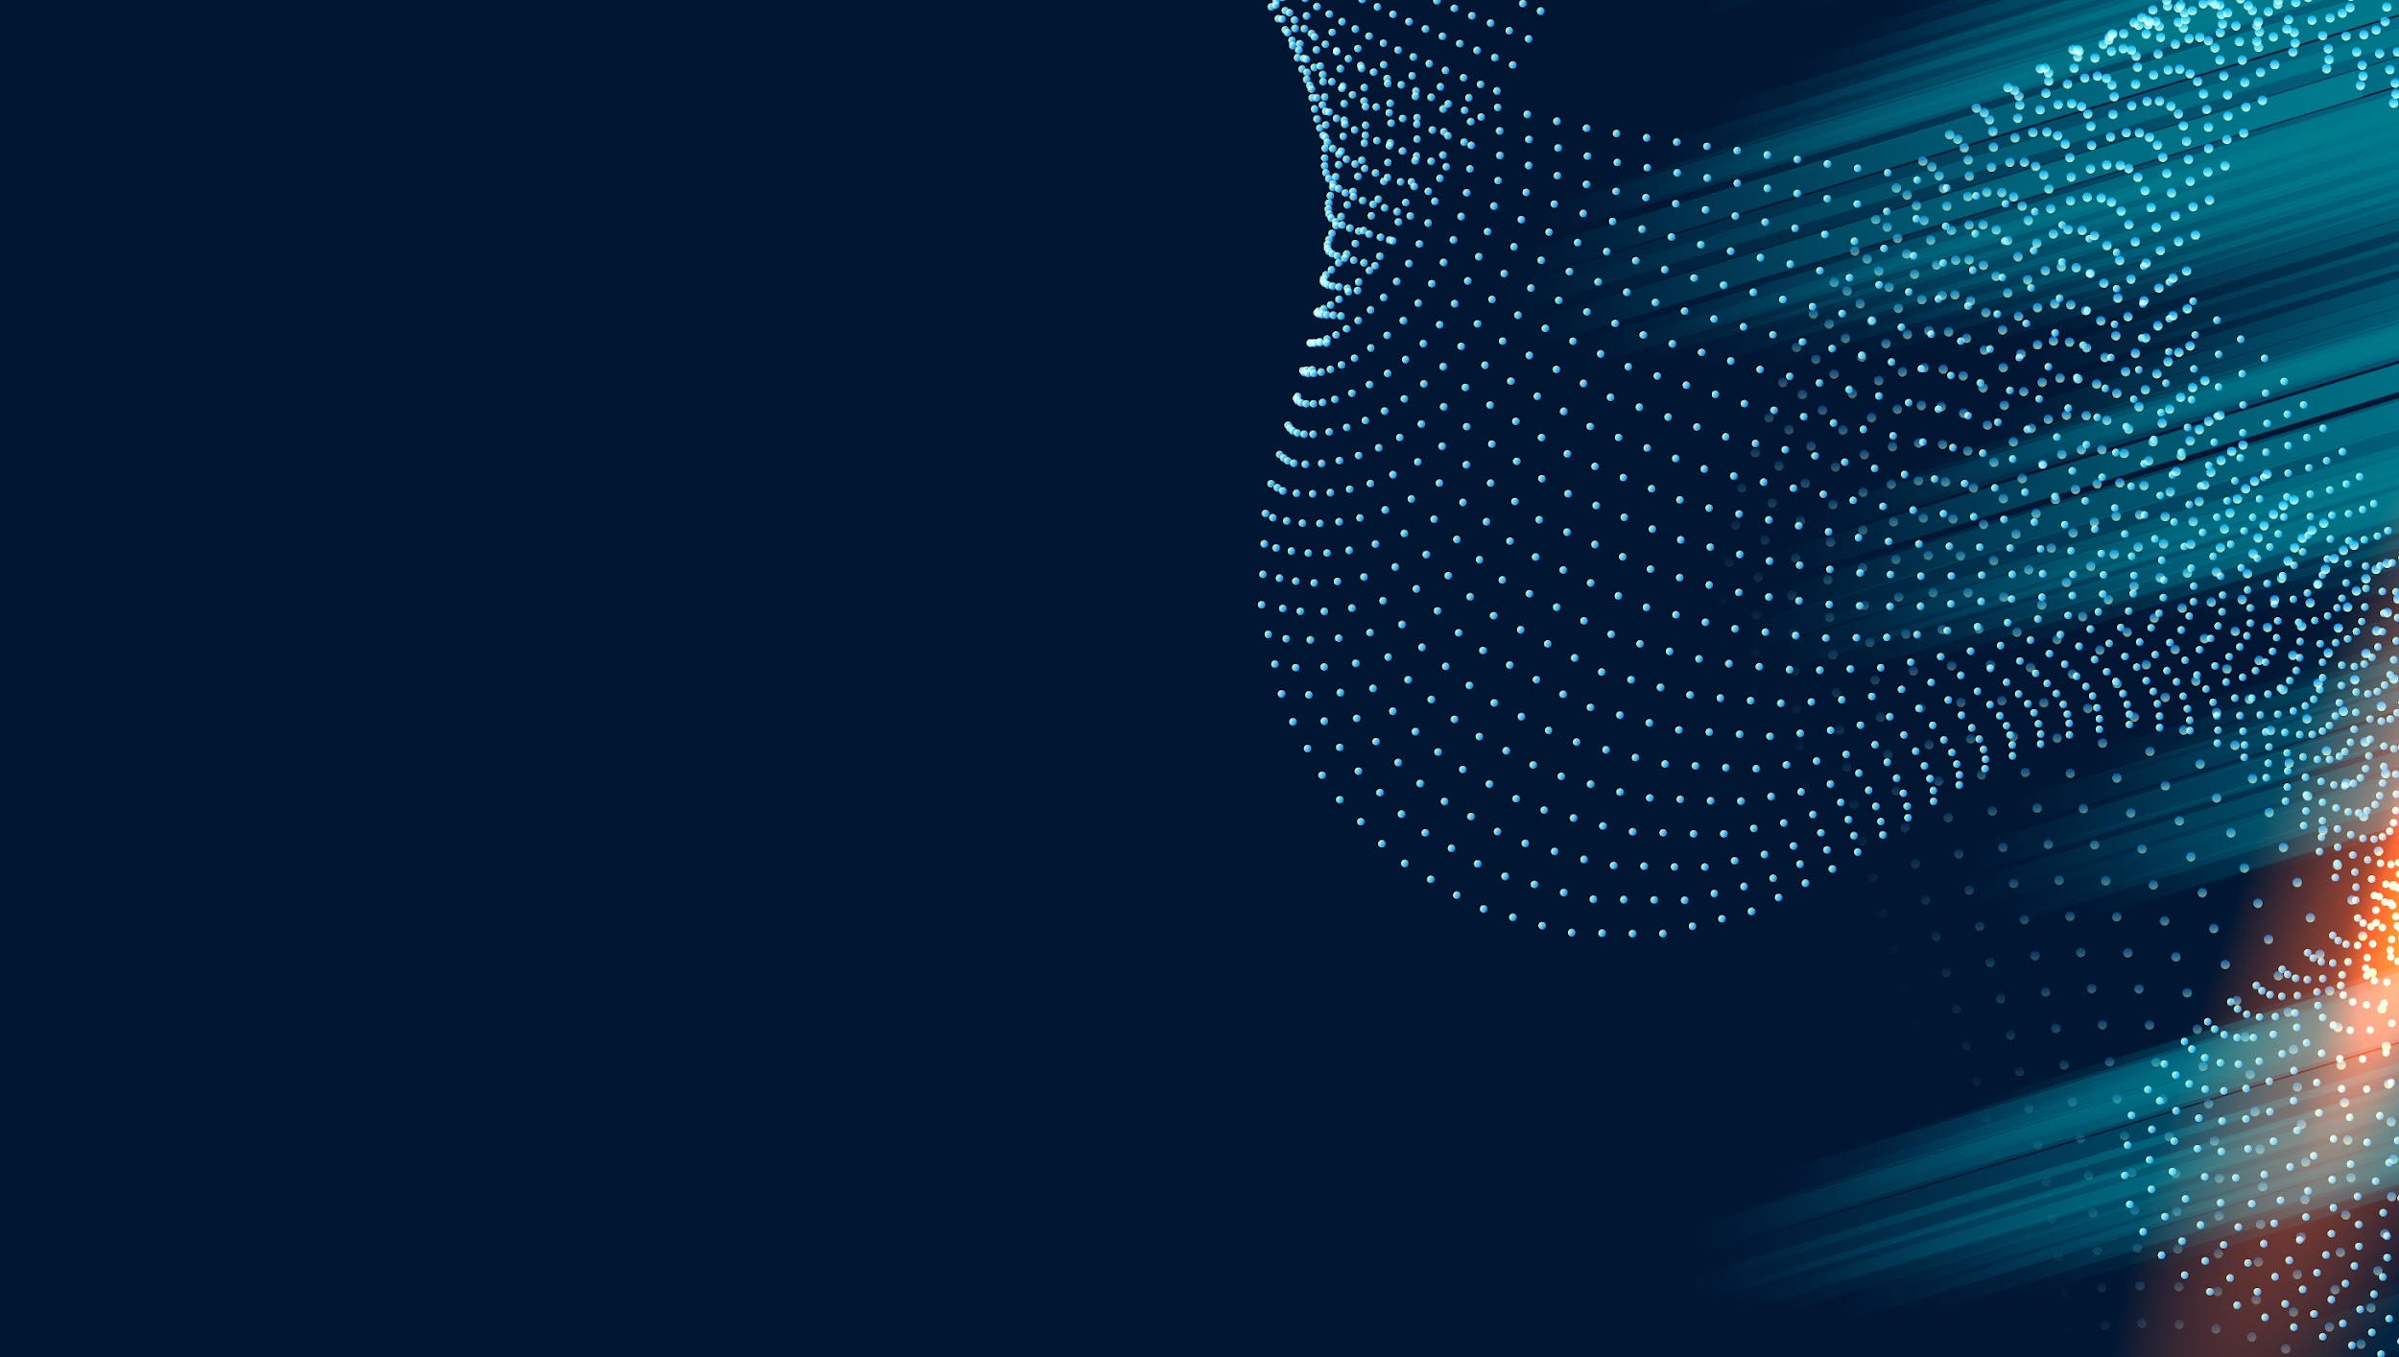
FUTURISTIC BACKGROUND
INFOGRAPHICS
Here is where this template begins

Slide 2

ABOUT FUTURISTIC BACKGROUND INFOGRAPHICS
This template contains an assortment of complementary infographic resources for the Futuristic Background presentation.
These infographics are adapted to the style of the aforementioned presentation, so you can insert them easily and have them completely integrated at once. You just need to do the following:
Select the element that you want to copy
Right-click and choose “Copy”
Go to the slide where you want the element to appear
Right-click and choose “Paste”

Slide 3

FUTURISTIC BACKGROUND INFOGRAPHICS
https://fincog.nl/blog/22/how-to-successfully-build-a-digital-bank
01
MERCURY
Mercury is the closest planet to the Sun
02
VENUS
Venus is the second planet from the Sun
03
MARS
Mars is actually a very cold place
04
SATURN
It’s a gas giant and has several rings
05
JUPITER
Jupiter is the biggest planet of them all

Slide 4

FUTURISTIC BACKGROUND INFOGRAPHICS
MERCURY
01
Mercury is the smallest planet of them all
NEPTUNE
02
03
It’s the farthest planet from the Sun
SATURN
It’s a gas giant and the ringed one

Slide 5
FUTURISTIC BACKGROUND INFOGRAPHICS
01
02
03
04
MERCURY
SATURN
VENUS
MARS
Mercury is the smallest planet
It’s a gas giant and has rings
Venus has a beautiful name
Mars is actually a cold place

Slide 6
FUTURISTIC BACKGROUND INFOGRAPHICS
01
MERCURY
Mercury is the closest planet to the Sun
02
It’s a gas giant and has several rings
SATURN
03
VENUS
Venus is the second planet from the Sun
04
Neptune is the farthest planet from the Sun
NEPTUNE

Slide 7
FUTURISTIC BACKGROUND INFOGRAPHICS
60%
80%
20%
MERCURY
VENUS
MARS
Mercury is the closest planet to the Sun and
the smallest one
Venus has a beautiful name and is the second planet from the Sun
It’s the fourth planet from the Sun and is actually a cold place

Slide 8
FUTURISTIC BACKGROUND INFOGRAPHICS
MERCURY
SATURN
Mercury is the smallest planet
It’s a gas giant and has rings
VENUS
NEPTUNE
Venus has a beautiful name
Neptune is very far away
MARS
JUPITER
Mars is actually a cold place
Jupiter is the biggest planet

Slide 9
FUTURISTIC BACKGROUND INFOGRAPHICS
MERCURY
01
Mercury is the closest planet to the Sun
MARS
02
04
SATURN
It’s the fourth planet from the Sun
Saturn is composed of hydrogen and helium
03
NEPTUNE
Neptune is the farthest planet from the Sun

Slide 10
FUTURISTIC BACKGROUND INFOGRAPHICS
01
MERCURY
Mercury is the smallest and closest planet to the Sun
02
JUPITER
It’s the fifth planet from the Sun and the largest in the Solar System
03
MARS
It’s the fourth planet from the Sun and is actually a cold place
04
SATURN
It’s a gas giant with a radius of about nine times that on Earth
05
NEPTUNE
It’s the eighth and farthest known solar planet of them all

Slide 11
FUTURISTIC BACKGROUND INFOGRAPHICS
MERCURY
MARS
Mercury is the closest planet to the Sun and
the smallest one
It’s the fourth planet from the Sun and is actually a cold place
VENUS
NEPTUNE
Venus has a beautiful name and is the second planet from the Sun
It’s the eighth and farthest-known solar planet from the Sun

Slide 12
FUTURISTIC BACKGROUND INFOGRAPHICS
MERCURY
MARS
NEPTUNE
01
02
03
Mercury is the smallest planet
Mars is actually a cold place
Neptune is very far away
VENUS
SATURN
JUPITER
04
05
06
Venus has a beautiful name
Saturn is the ringed planet
Jupiter is the biggest planet

Slide 13
FUTURISTIC BACKGROUND INFOGRAPHICS
01
02
03
04
MARS
JUPITER
NEPTUNE
VENUS
Despite being red, Mars is actually a cold place
It’s the fifth planet from the Sun and the largest
It’s the eighth and farthest-known solar planet
Venus is the second planet from the Sun

Slide 14
FUTURISTIC BACKGROUND INFOGRAPHICS
01
02
03
04
MARS
SATURN
NEPTUNE
VENUS
It’s the fourth planet from the Sun and is a very cold place
It’s a gas giant with a radius of about nine times that on Earth
Neptune is the fourth-largest planet in the Solar System
Venus has a beautiful name, but also high temperatures

Slide 15
FUTURISTIC BACKGROUND INFOGRAPHICS
MERCURY
VENUS
MARS
SATURN
Mercury is the smallest planet
Venus has a beautiful name
Mars is actually a cold place
It’s a gas giant and has rings

Slide 16
FUTURISTIC BACKGROUND INFOGRAPHICS
MERCURY
Mercury is the closest planet to the Sun and
the smallest one
01
MARS
It’s the fourth planet from the Sun and is actually a cold place
VENUS
Venus has a beautiful name and is the second planet
02
03

Slide 17
FUTURISTIC BACKGROUND INFOGRAPHICS
MERCURY
01
Mercury is the closest planet to the Sun
NEPTUNE
02
It’s the eighth and farthest known solar planet
VENUS
03
Venus has a beautiful name and is the second planet
VENUS
04
Venus is the second planet from the Sun
SATURN
05
Saturn is composed mostly of hydrogen and helium

Slide 18
FUTURISTIC BACKGROUND INFOGRAPHICS
MERCURY
50%
SATURN
30%
Mercury is the closest planet to the Sun and the smallest one
It’s a gas giant with a radius of about nine times that on Earth
JUPITER
70%
VENUS
10%
It’s the fifth planet from the Sun and the largest of them all
Venus has a beautiful name, but also very high temperatures

Slide 19
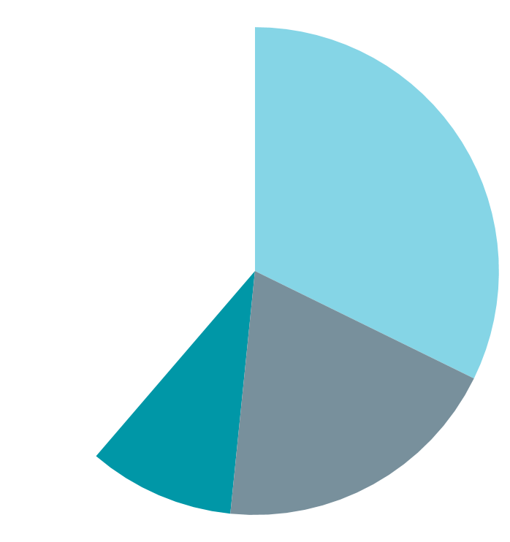
FUTURISTIC BACKGROUND INFOGRAPHICS
MERCURY
SATURN
Mercury is the closest planet to the Sun and the smallest one
It’s a gas giant with a radius of about nine times that on Earth
39%
32%
JUPITER
VENUS
It’s the fifth planet from the Sun and the largest of them all
19%
Venus has a beautiful name, but also very high temperatures
10%
Follow the link in the graph to modify its data and then paste the new one here. For more info, click here

Slide 20
FUTURISTIC BACKGROUND INFOGRAPHICS
01
MERCURY
Mercury is the closest planet to the Sun
02
VENUS
Venus is the second planet from the Sun
03
MARS
Mars is actually a really cold place
04
SATURN
It’s a gas giant and has several rings

Slide 21
FUTURISTIC BACKGROUND INFOGRAPHICS
MERCURY
VENUS
MARS
Mercury is the smallest planet
Venus has a beautiful name
Mars is actually a cold place
SATURN
NEPTUNE
It’s a gas giant and has rings
Neptune is the farthest planet

Slide 22
FUTURISTIC BACKGROUND INFOGRAPHICS
MERCURY
01
Mercury is the closest planet to the Sun and the smallest one
SATURN
02
Saturn is a gas giant and has several rings around
VENUS
03
Venus has a beautiful name, but also high temperatures
EARTH
04
Earth is the only known planet to harbor life in the Solar System
MARS
05
Despite being red, Mars is actually a really cold place

Slide 23
FUTURISTIC BACKGROUND INFOGRAPHICS
01
02
03
04
05
VENUS
JUPITER
NEPTUNE
SATURN
EARTH
Venus is the second planet from the Sun
Jupiter is the biggest planet of them all
It’s the farthest planet from the Sun
It’s a gas giant and has several rings
It’s the third planet from the Sun

Slide 24
FUTURISTIC BACKGROUND INFOGRAPHICS
JUPITER | It’s the fifth planet from the Sun and the largest of them all
MARS | It’s the fourth planet from the Sun and a cold place
SATURN | Saturn is composed mostly of hydrogen and helium
NEPTUNE | It’s the eighth and farthest known solar planet

Slide 25
FUTURISTIC BACKGROUND INFOGRAPHICS
01
03
MARS
02
NEPTUNE
Despite being red, Mars is actually a cold place
It’s the eighth and farthest-known solar planet
JUPITER
It’s the fifth planet from the Sun and the largest

Slide 26
FUTURISTIC BACKGROUND INFOGRAPHICS
MERCURY
Mercury is the closest planet to the Sun and the smallest one
60%
SATURN
25%
It’s a gas giant with a radius of about nine times that on Earth
JUPITER
It’s the fifth planet from the Sun and the largest of them all
35%

Slide 27
FUTURISTIC BACKGROUND INFOGRAPHICS
72%
Jupiter is the fifth planet from the Sun and the largest in the Solar System
30%
Mars is the fourth planet from the Sun and a cold place
51%
Saturn is composed mostly of hydrogen and also helium
86%
Neptune is the eighth and farthest known solar planet

Slide 28
FUTURISTIC BACKGROUND INFOGRAPHICS
MERCURY
MARS
NEPTUNE
01
02
03
Mercury is the smallest planet
Mars is actually a cold place
Neptune is very far away
VENUS
SATURN
JUPITER
06
05
04
Venus has a beautiful name
It’s a gas giant and has rings
Jupiter is the biggest planet

Slide 29
FUTURISTIC BACKGROUND INFOGRAPHICS
01
03
JUPITER
NEPTUNE
MARS
SATURN
It’s the fifth planet from the Sun and the largest
It’s the eighth and farthest-known solar planet
Despite being red, Mars is actually a cold place
Saturn is a gas giant and has several rings
02
04

Slide 30
FUTURISTIC BACKGROUND INFOGRAPHICS
JUPITER
SATURN
It’s is the biggest planet of them all
It’s a gas giant and has several rings
MERCURY
VENUS
Mercury is the smallest planet
Venus has a beautiful name
NEPTUNE
MARS
Neptune is very far away from Earth
Despite being red, it’s a cold place

Slide 31
FUTURISTIC BACKGROUND INFOGRAPHICS
MERCURY
SATURN
02
04
Mercury is the smallest planet
It’s a gas giant and has rings
JUPITER
NEPTUNE
VENUS
01
03
05
Jupiter is the biggest planet
Neptune is the farthest planet
Venus has a beautiful name

Slide 32
FUTURISTIC BACKGROUND INFOGRAPHICS
01
05
MARS
SATURN
Mars is actually a cold place
It’s a gas giant and has rings
02
03
04
MERCURY
NEPTUNE
VENUS
Mercury is the smallest planet
Neptune is very far away
Venus has a beautiful name

Slide 33
FUTURISTIC BACKGROUND INFOGRAPHICS
MERCURY
01
Mercury is the closest planet to the Sun
VENUS
02
Venus is the second planet from the Sun
NEPTUNE
03
It’s the farthest planet from the Sun
MARS
04
Despite being red, it’s actually a cold place
TARGET

Slide 34
Instructions for use
In order to use this template, you must credit Slidesgo in your final presentation.
You are allowed to:
- Modify this template.
- Use it for both personal and commercial projects.
You are not allowed to:
- Sublicense, sell or rent any of Slidesgo Content (or a modified version of Slidesgo Content).
- Distribute Slidesgo Content unless it has been expressly authorized by Slidesgo.
- Include Slidesgo Content in an online or offline database or file.
- Offer Slidesgo templates (or modified versions of Slidesgo templates) for download.
- Acquire the copyright of Slidesgo Content.
For more information about editing slides, please read our FAQs or visit Slidesgo School:
https://slidesgo.com/faqs and https://slidesgo.com/slidesgo-school

Slide 35
Instructions for use (premium users)
As a Premium user on Slidesgo, you can use this template without crediting us.
You are allowed to:
Modify this template.
Use it for both personal and commercial purposes.
Hide or delete the “Thanks” slide and the mention to Slidesgo in the credits.
Share this template in an editable format with people who are not part of your team.
You are not allowed to:
Sublicense, sell or rent this Slidesgo Template (or a modified version of this Slidesgo Template).
Distribute this Slidesgo Template (or a modified version of this Slidesgo Template) or include it in a database or in any other product or service that offers downloadable images, icons or presentations that may be subject to distribution or resale.
Use any of the elements that are part of this Slidesgo Template in an isolated and separated way from this Template.
Register any of the elements that are part of this template as a trademark or logo, or register it as a work in an intellectual property registry or similar.
For more information about editing slides, please read our FAQs or visit Slidesgo School:
https://slidesgo.com/faqs and https://slidesgo.com/slidesgo-school

Slide 36
Infographics
You can add and edit some infographics to your presentation to present your data in a visual way.
Choose your favourite infographic and insert it in your presentation using Ctrl C + Ctrl V or Cmd C + Cmd V in Mac.
Select one of the parts and ungroup it by right-clicking and choosing “Ungroup”.
Change the color by clicking on the paint bucket.
Then resize the element by clicking and dragging one of the square-shaped points of its bounding box (the cursor should look like a double-headed arrow). Remember to hold Shift while dragging to keep the proportions.
Group the elements again by selecting them, right-clicking and choosing “Group”.
Repeat the steps above with the other parts and when you’re done editing, copy the end result and paste it into your presentation.
Remember to choose the “Keep source formatting” option so that it keeps the design. For more info, please visit Slidesgo School.

